Slide 1
GS POC-AWS-ECS
Technology Stack/Details for POC

Slide 2
Technologies Used :-
Cloud Platform :- AWS
Webserver :- Apache
Application Server :- wordpress
Database :- RDS(MySql)
DNS Routing :- AWS Route 53
Server Authorization :- AWS IAM/Roles
Code Repository :- Github

Slide 3




Architecture
User
-Wordpress Appserver
Apache Webserver
Private subnet 1
Private subnet 1
AWS-MySql DataBase
Internal
ALB
External
ALB
Wordpress Appserver
Apache Webserver
Private subnet 2
Private subnet 2

Slide 4
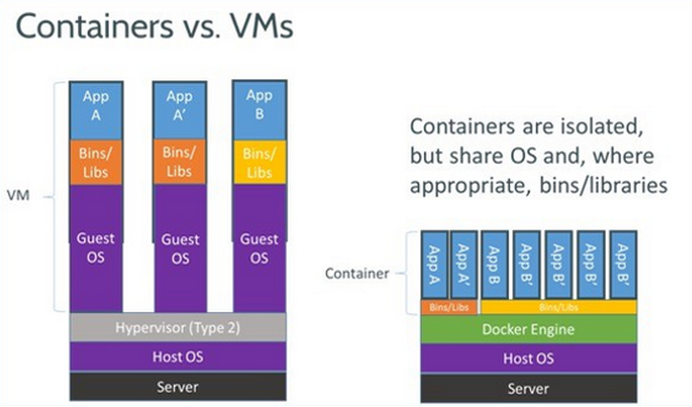
Docker -Component

Slide 5
Docker
Docker: -
Docker is a computer program that performs operating-system-level virtualization also known as containerization. It was first released in 2013 and is developed by Docker, Inc. Docker is used to run software packages called "containers"
IMAGES
An image is a read-only template with instructions for creating a Docker container
Containers: -
A container image is a lightweight, stand-alone, executable package of a piece of software that includes everything needed to run it: code, runtime, system tools, system libraries, settings.

Slide 6
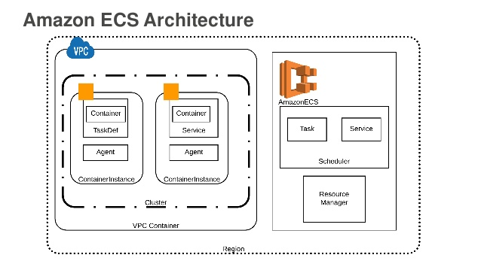
ECS Architecture
ECR

Slide 7
ECS :
What is Amazon Elastic Container Service?
Amazon Elastic Container Service (Amazon ECS) is a highly scalable, fast, container management service that makes it easy to run, stop, and manage Docker containers on a cluster
Amazon Elastic Container Registry(ECR):
Elastic Container Registry (ECR) is a fully-managed Docker container registry that makes it easy for developers to store, manage, and deploy Docker container images
Amazon ECS Clusters
An Amazon ECS cluster is a logical grouping of tasks or services. If you are running tasks or services that use the EC2 launch type, a cluster is also a grouping of container instances.

Slide 8
ECS
Service:
Service resource creates an Amazon Elastic Container Service (Amazon ECS) service that runs and maintains the requested number of tasks and associated load balancers.
TaskDefinition :
TaskDefinition resource describes the container and volume definitions of an Amazon Elastic Container Service (Amazon ECS) task.You can specify which Docker images to use, the required resources, and other configurations related to launching the task definition through an Amazon ECS service or task.
Amazon RDS:
Amazon Relational Database Service (Amazon RDS) makes it easy to set up, operate, and scale a relational database in the cloud

Slide 9
AWS-S3 and Cloudformation
Amazon S3
Amazon S3 is a cloud computing web service offered by Amazon Web Services. Amazon S3 provides object storage through web services interfaces
Cloudformation
AWS CloudFormation provides a common language for you to describe and provision all the infrastructure resources in your cloud environment. CloudFormation allows you to use a simple text file to model and provision, in an automated and secure manner, all the resources needed for your applications across all regions and accounts.

Slide 10
GitHub URL:
Please find the github URL for this POC
https://github.com/kamlesh1984/aws-ecs-wp.git

